Slide 1

Hardening New York City Water/Wastewater Infrastructures Against Extreme Weather Events and Cyberattacks
Team: Seung Hwa Lee, Vaishnavi Muthukrishnan, Wonchan Lee
Sponsors: Charalampos Avraam, PhD, Yury Dvorkin, PhD
Project Presentation
07.28.22
Image credits : TechCrunch
Notes:
Vaishnavi: Hi I am Vaishnavi Muthukrishnan, I have a background in data analytics and management consulting. I have a research interest in using data science for addressing climate change through decarbonization, energy transition and building resilience.

Slide 2
Agenda
Motivation and Intention
Need for the project
Key research questions
Scenarios
Wastewater
Water Distribution
Conclusions
Challenges and Limitation
Contribution

Slide 3
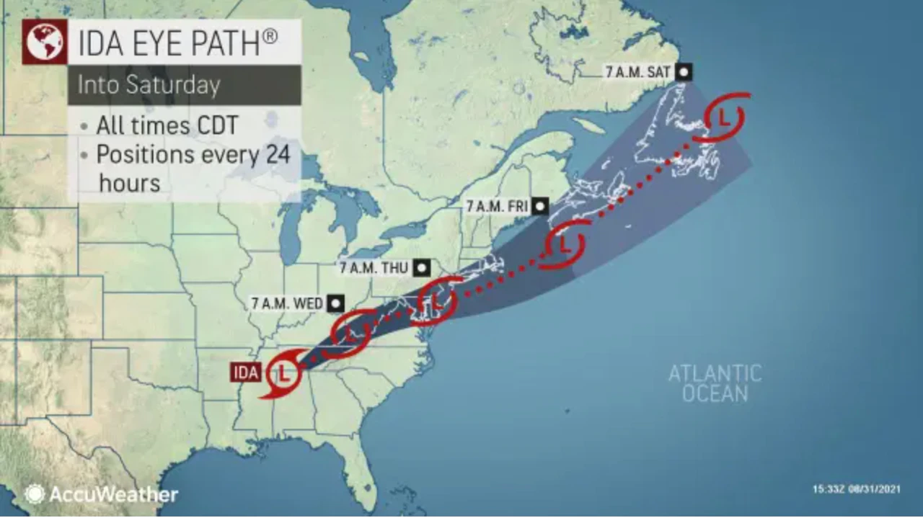
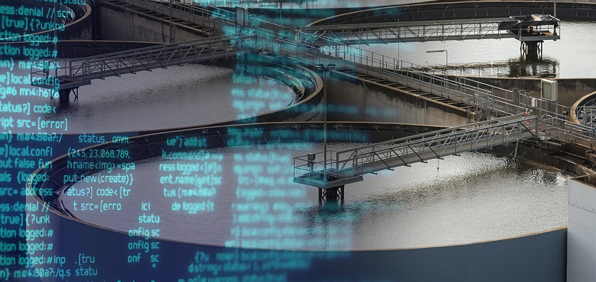
Natural Hazards and Cyber-attacks disrupt critical infrastructures
Hurricane Ida
57,000 power outages
Damage of ~$95 billion
~200 water utilities experienced outage
Florida Water Treatment Plant Cyberattack
Hackers attacked water-treatment system in Oldsmar, FL
Attempted to raise the level of sodium hydroxide
Concerning despite safeguard
Notes:
Extreme events such as natural hazards and cyber attack have been causing disruptions throught many years. For exapmple , Hurricane Ida struck NYC in spetember 2021 causing 5700 power outtage , floods and total damage of at least 95 billion dollars. Nearly two hundred water systems, large and small, are experiencing outages after the powerful storm
On 2021, feb 5 , unkown hackers attacked the water plant and tried to raise level of sodium hydoxide. Luckly, the water treatment staff noticed it very shortly and was able to prevent the relise of the water.Although there is also automatic safeguard system that monitor the water quality , it is still concern for many people.

Slide 4
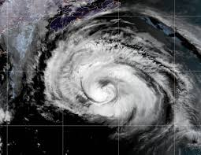


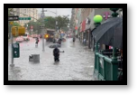
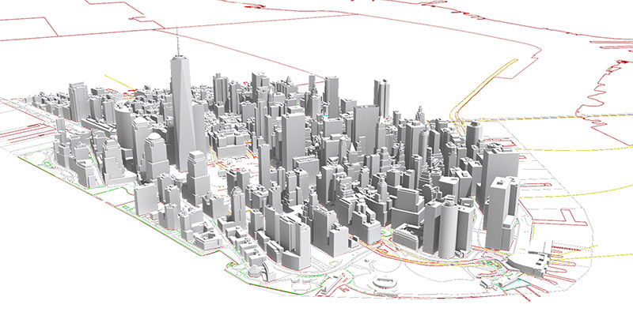

Need to understand NYC’s Infrastructure Vulnerabilities
Extreme Events(Natural Hazard,Cyber attack)
Natural Disaster
Cyber attack
Stress regional water and wastewater infrastructures
Need to map out the system’s vulnerabilities to build resilience
Water Treatment Plant
Notes:
To minimize future disruptions, similar to previous examples that stresses regional water and electricity infrastructures
we need to Identify NYC's water and electricity Infrastructure and Understand interdependencies
Identify NYC's water and electricity Infrastructure vulnerabilities; Understand interdependencies

Slide 5
Research Questions
What are techno-economic characteristics of water, wastewater infrastructures?
Which water, and wastewater components are most vulnerable under extreme events?
Notes:
So these are our research questions.
Through the question we have gathered spatial information, capacity, working and population imapct of these diff infrastructures which would help us to andswer 2nd question, which is finding most vulneralbe components under extreme events
Finally, This lead us to understand how we can prepare and set up a strategy for the city for such events,
25 sec

Slide 6
Agenda
Motivation and Intention
Need for the project
Key research questions
Scenarios
Wastewater
Water Distribution
Conclusions
Challenges and Limitation
Contribution
Notes:
We will talk in detail about the progress so far in next part

Slide 7
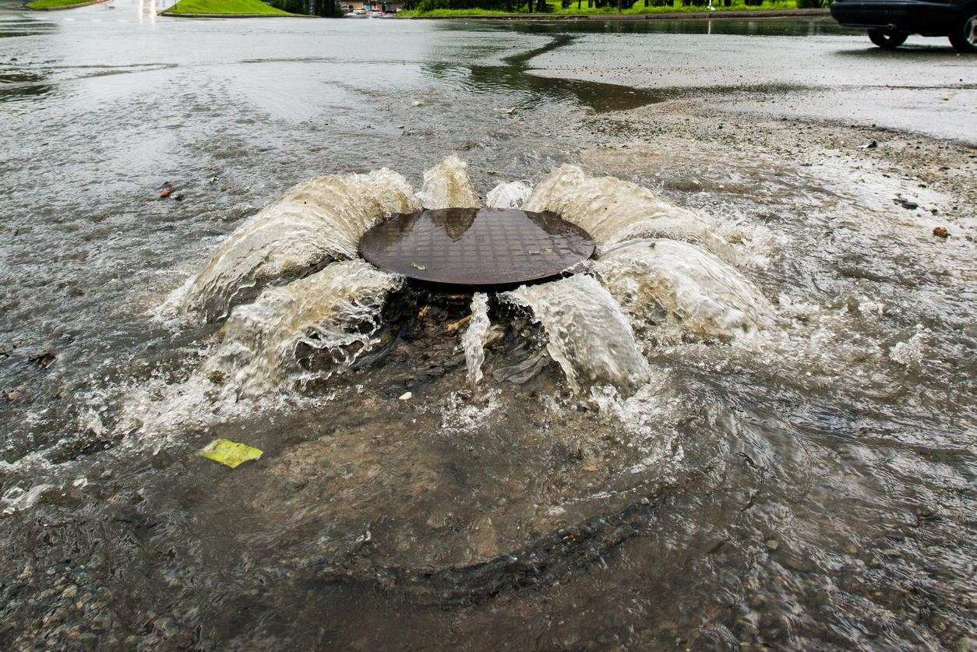
Where does our wastewater go?

Slide 8
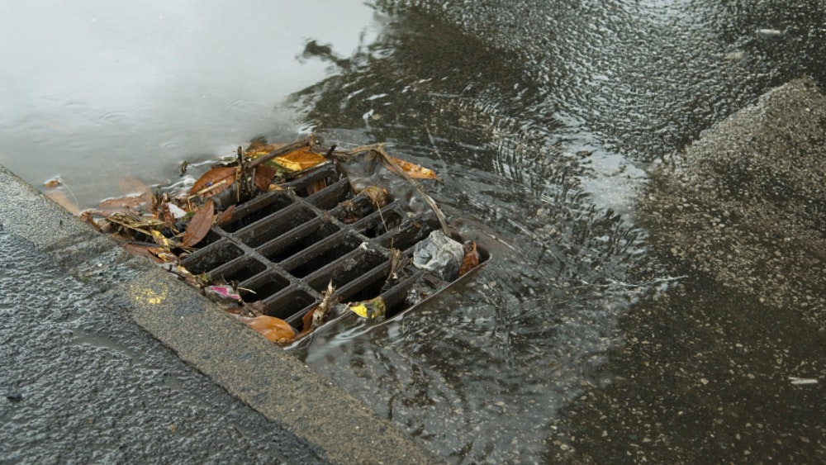
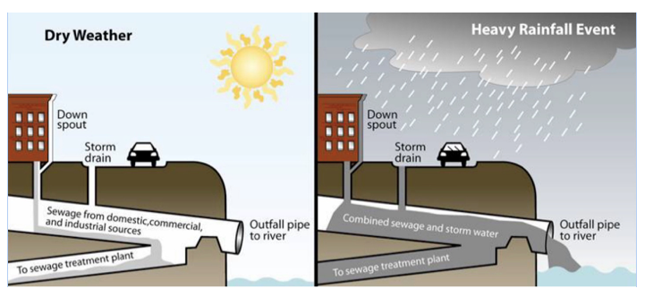
NYC’s sewers overwhelmed by rains
Potential Health Impact [5]
Diarrhea and nausea
Hormonal disfunction
Cancer
Waterways Hazards
Aquatic life contamination
Financial burden on communities to cleanup
Notes:
New York City’s wastewater infrastructure is comprised of an extensive network of over 7,400 miles of sewer pipes that collect sanitary sewage and stormwater, and the 14 Wastewater Resource Recovery Facilities (WRRFs) that receive the flow. NYC’s sewer system is approximately 60 percent combined, which means it is used to convey both sanitary and storm flows. When the sewer system is at full capacity, a diluted mixture of rainwater and sewage may be released into the local waterways. This is called a combined sewer overflow (CSO).

Slide 9
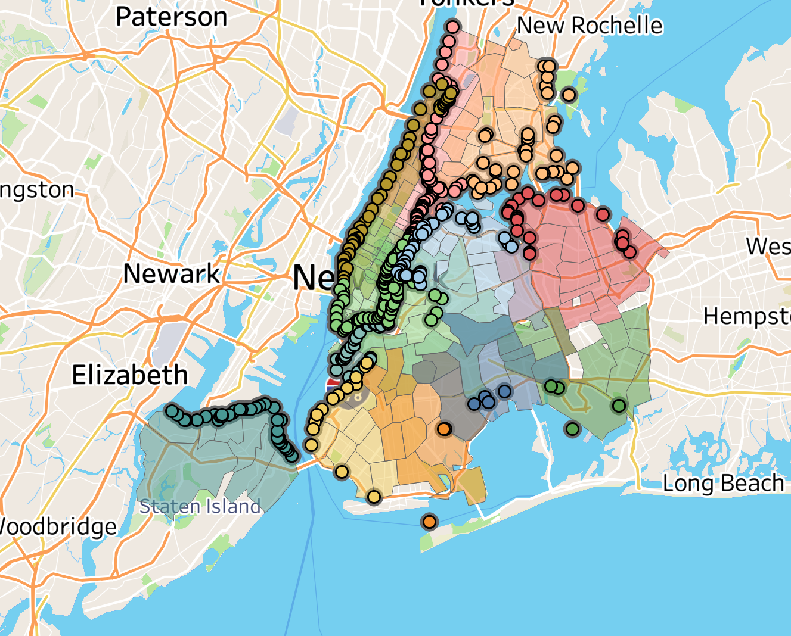
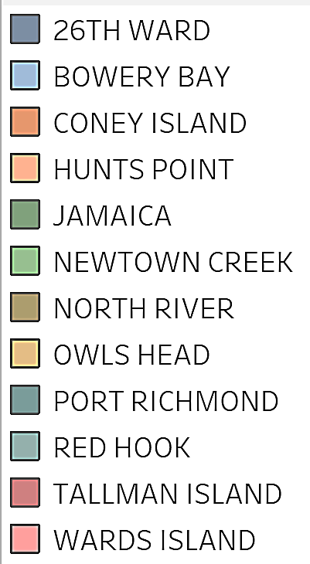
Wastewater Infrastructure
No existing end to end data!
Combined Sewer Outflows draining into different plants
Combined Sewer Outflows + Precipitation + Water demand + Treatment Facilities =
Wastewater infrastructure
Notes:
We wanted to analyze the impact of natural and man-made disruptions on this system, but for doing any modeling and analysis , we needed end to end data about the wastewater infrastructure of the city which was not available through open data sources. So, we created a complete NYC wastewater infrastructure database with data collected from research papers, agency reports and open data portals to trace the journey of NYC’s water after it is supplied to the city for consumption or through rain. We processed each zip code’s water consumption and precipitation data and connected it to the respective wastewater treatment plants. We also collected information about each treatment plant’s location, capacity and daily inflow of wastewater.

Slide 10
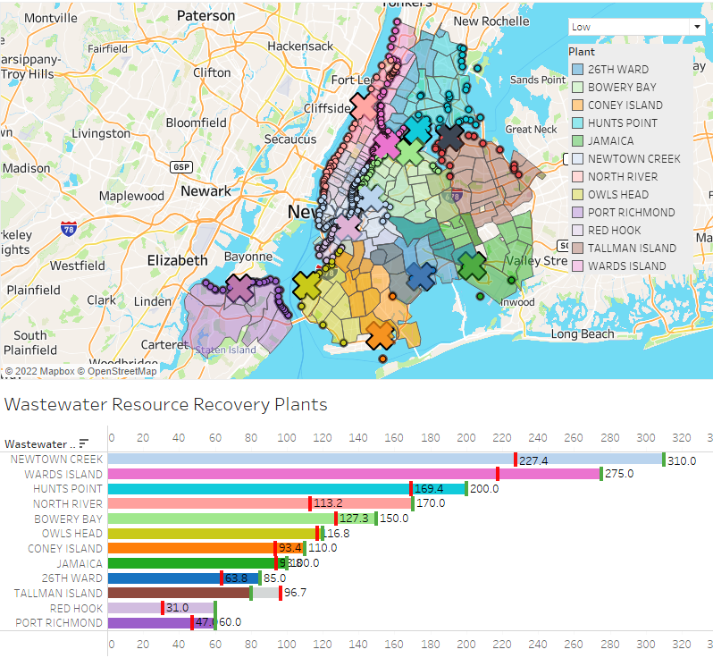
How NYC handles low rainfall
Combined Sewer Outflows draining into different plants
A flooded plant already!
Notes:
We used the average zipcode wise precipitation data to understand how the system comes under pressure during different rainfall levels. This pressure level was understood by comparing the capacity of a treatment plant against the flow into the plant from all its drainage zips. We assumed that anytime the flow crosses the capacity, the overflow is directly released into the drainage waterway of each combined sewer outflow. For this scenario of low rainfall, Tallman Island plant’s capacity is only 80 MGD, while the overflow from its drainage zipcodes in Queens is 96.7 MGD, so 16 MGD of water is released into the waterways near Queens.

Slide 11
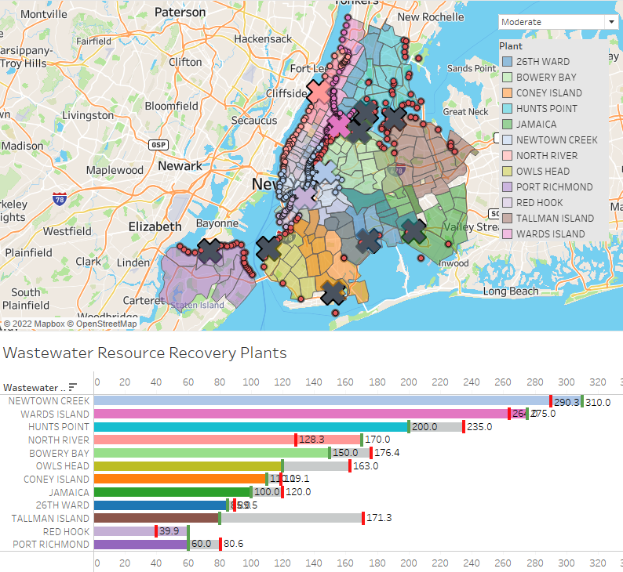
How NYC handles moderate rainfall
Combined Sewer Outflows draining into different plants
Half the plants not working
A flooded plant already!
Notes:
For moderate rainfall (of 0.3 inches of rain/ hour), 50% of the treatment plants in Queens, Brooklyn and Staten Island are overwhelmed while the overflow from its drainage zipcodes is released into the waterways

Slide 12
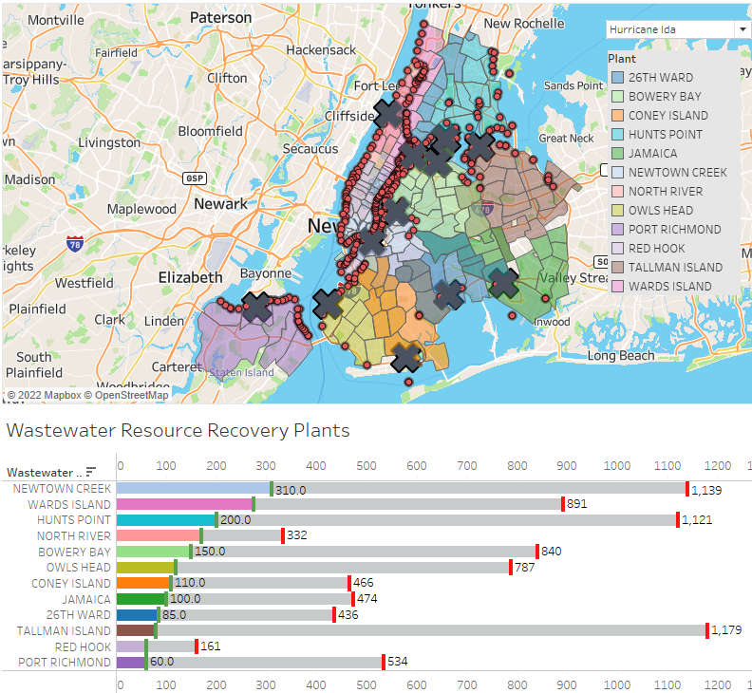
How NYC handles Ida level rainfall
Combined Sewer Outflows draining into different plants
NYC’s sewer system overloaded!
Notes:
We all know the wreakage that hurricane Ida inflicted on the city, the flooded subways, the powercuts and in general shut down of the city. During an Ida level rainfall, all treatment plants are shut down both due to flooding and loss of electricity, and all of the precipitation and consumption sewage is dumped into the open waterway, causing high levels of toxicity to be mixed into water around the city.

Slide 13
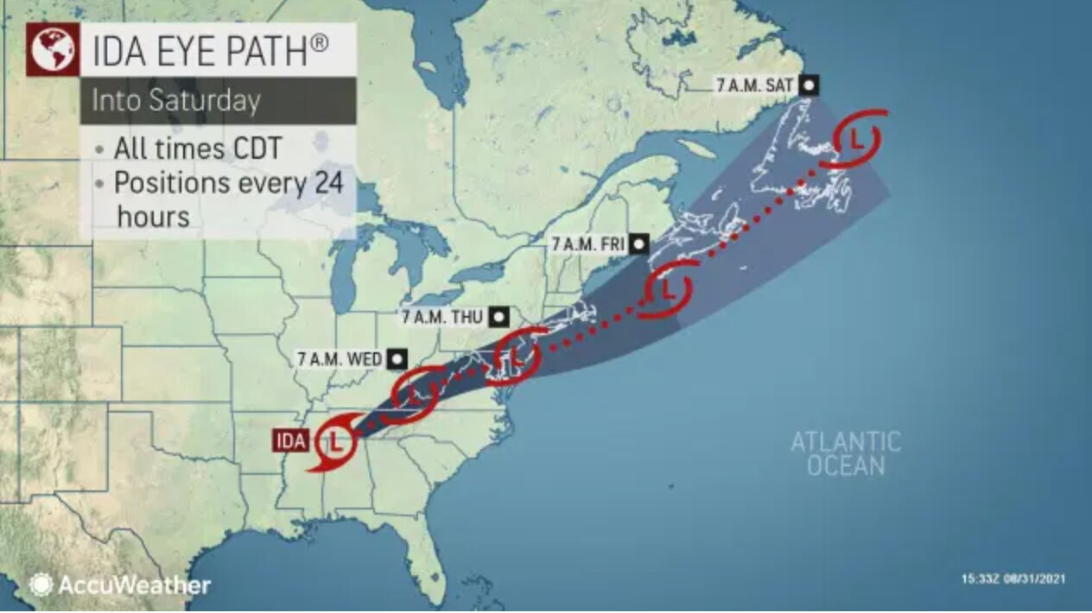
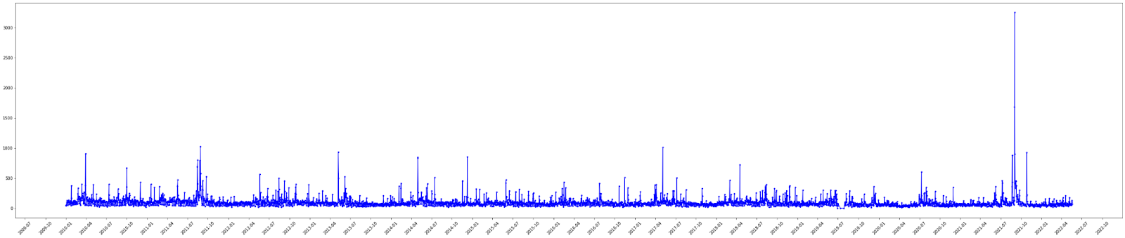
Hurricane Ida (2021/8/26-2021/9/4)
NYC's aging sewers infrastructure
Growing concern over climate change
Sewer Complaints (2010/1/1-2022/6/28) (3 months Interval ) all of NYC
Notes:
Therefore , Extreme weather events like hurricane IDA have raised concerns over climate change and NYC's aging sewer infrastructure. As we can see in this time plot , there has been dramatic increase in number of sewer complaints reported during hurricane IDA.

Slide 14
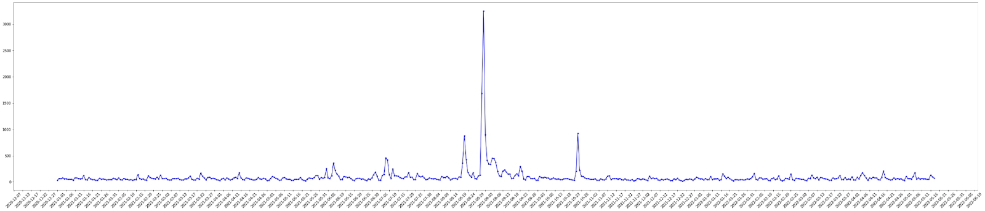
Sewer Complaints
Sewer Complaints IDA (2021/8/26-2021/9/4), the plot for 12/31/2020-2022/06/14 (5 days Interval)
Notes:
If we take a closer look in 5 day interval , the number of complaints on sewer system increased starting August 26 and the spike remianed high until spetember 4th. From this we can expect that number of Sewer complaints is highly affected by
Extreme weather conditions. Therefore we decided to use number of complaints reported during hurricane Ida as a representative of citizens affected by extreme weather events

Slide 15
Predicting Impact of Extreme Weather
Are certain areas impacted more by sewage overflow?
Can we predict areas affected by extreme weather events?
Notes:
So, our main goal is to analyze if certain areas are disproportionately affected by sewage overflow. We tried to predict the areas that are likely to be highly affected during extreme weather events due to certain conditions or features such as location. We further explored demographics of areas impacted.

Slide 16
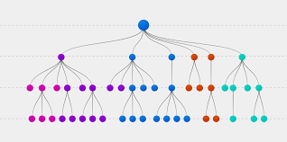
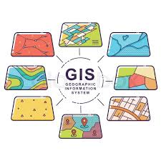

Methodology
Data inputs
Methods
% increase in CSO discharge
Number of NYC Sewer Complaints
Distance from nearestCSO
Demographic Data

Slide 17
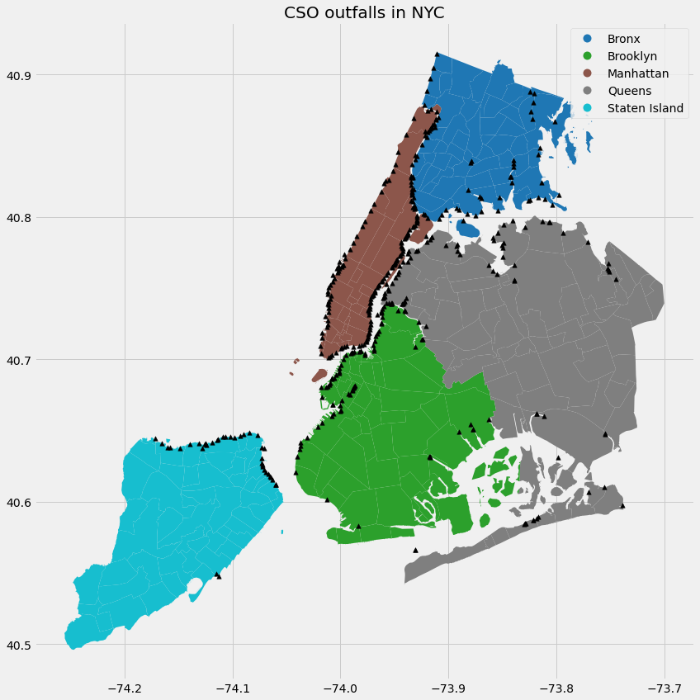
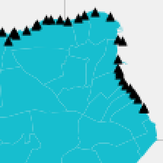
CSO discharge point
Center of ZIP
Methodology (Cont.)
Distance between center of each Zip and nearest CSO discharge point
(euclidean distance)

Slide 18
Distance from CSO a strong positive factor
IDA Discharge<=188.5 (Mgal/d)
High: > 5 complaints/ day
Low: < 5 complaints/ day
True
False
Distance from CSO<=1193
Asian % <=0.22
High
Black % <=0.34
Distance from CSO<=11582
Asian % <=0.34
IDA Discharge<=168 (Mgal/d)
Poverty rate<=0.03
Low
High
Distance from CSO<=2415
Poverty rate<=0.16
High
Low
High
Low
Low
Low
High
High
Notes:
We devided number of complaints in two levels high and low to find out which feature among amount of discharge during IDA , distance from discharge point , and demographic information is most corelated with high level of complaints.
We can observe that distance from nearest discharge point is one of the strongest factor in making decision.
However, we cannot say that certain features are highly related with the number of complaints so we took closer look at each features.

Slide 19
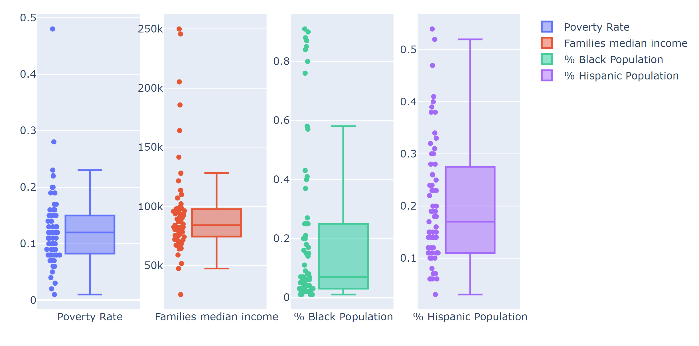
Black and Hispanic communities adversely impacted
Notes:
We took closer look on the demographics with high level of complaints , These are the featues of top 5 zipcodes with high level of compalints that had relatively noticible patterns.
poverty rate and family mdian is showing high bond in certain levels. We can see

Slide 20
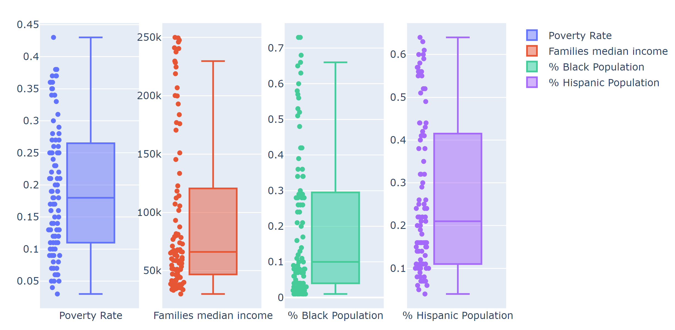
No correlated factors isolated for low complaint areas
Notes:
We also took a look at low complaints ,This is demographics of zip codes with low level of complaints, there are no specific pattern but demogrphics are well spreaded

Slide 21
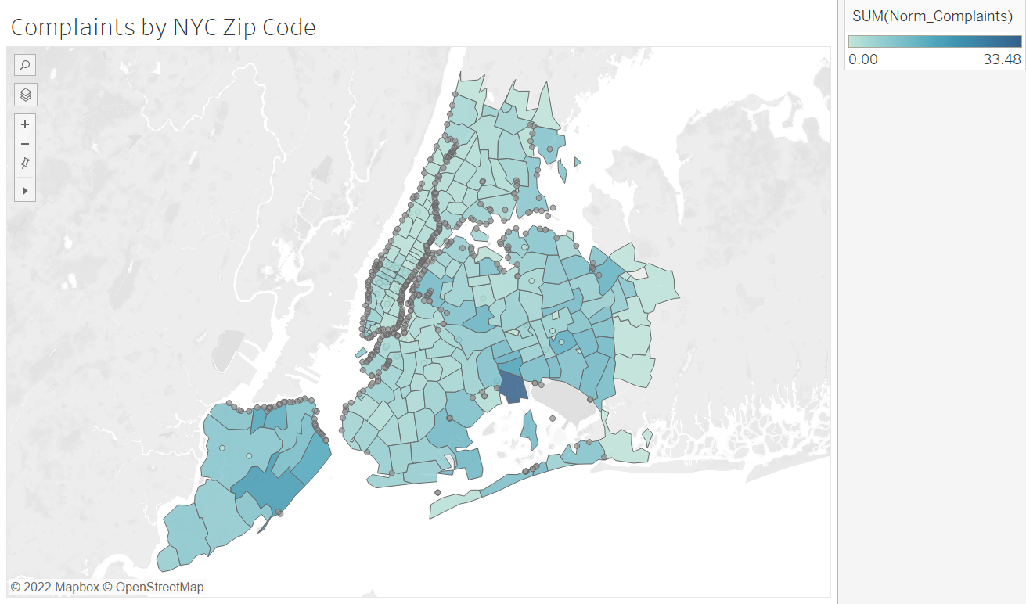
Complaints generally correlated to presence of CSO
Conclusion
Distance from CSO point
Areas with high risk during extreme weather events
Policy Implications
Focused reduction of Combined Sewer System in high impact areas

Slide 22
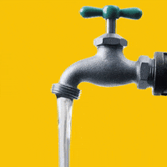
Water Distribution Network for NYC
Why should we care?
Notes:
Talk about the complexity of water distribution in NYC
Talk about the hard work in ensuring that one of the best water in the world is supplied to homes
Impact of disruption of the service or quality of service

Slide 23
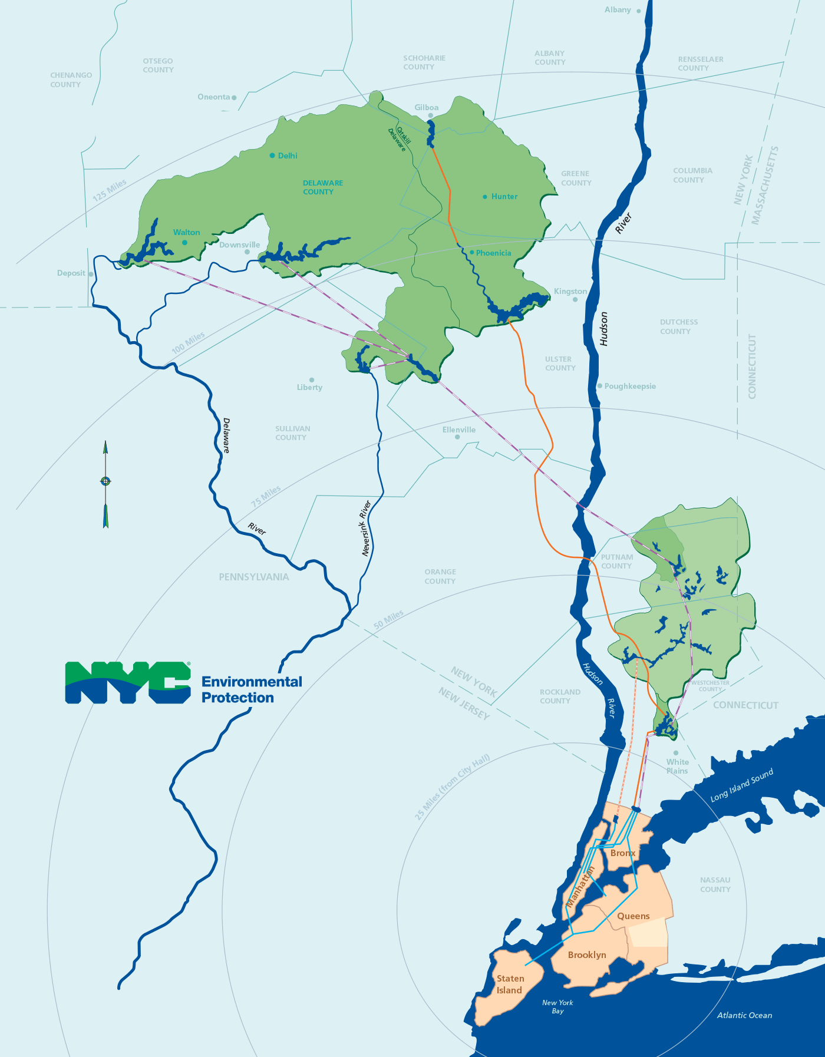



Water Supply Reservoirs
Schoharie Reservoir
Cannonsville Reservoir
Inputs
Capacity
Daily Outflow
Daily Storage for certain Reservoirs
Ashokan Reservoir
Pepacton Reservoir
Rondout Reservoir
Process
Reporting data from NYC Open Data, USGS and NYC Environmental Protection
Data extrapolation at Jerome Park Reservoir's Outflow Data
Neversink Reservoir
Challenges
Lack of comprehensive datasets
Data assumption and extrapolation
New Croton Reservoir
Jerome Park Reservoir
Notes:
NYC water supply system consists of three main watersheds: Catskill, Delaware and Croton. Catskill and Delaware are responsible for supplying about 90% of NYC's water supply and the rest from Croton. In order to observe how much water travels from these locations to the water treatment plant and to New York's citizens, we obtained data from different reservoirs that highlights capacity and daily outflow from February 2019 to end of February 2022. The visualization above shows different reservoirs at specific watersheds on February 28, 2022. Boxes highlighted in blue are reservoirs from Catskill and Delaware, whereas the ones in yellow are from Croton. Obtaining data for reservoirs from Catskill and Delaware were easily accessible from NYC Open Data, as well as data from New Croton Reservoir, which is the collecting point for water from all reservoirs in the Croton watershed. A challenge was faced when a discrepancy was found in the water treatment database where the Outflow from New Croton Reservoir into Croton Filtration Plant’s capacity. We were able to find that Jerome Park Reservoir is a storage reservoir for Croton watershed, which helped understand the possible inconsistency. By utilizing the IF statement on excel, we extrapolated the Outflow data from Jerome Park Reservoir, sticking with values that were less than the capacity of Croton Filtration Plant. From making the final database, we naturally got to learn more about the intricacy of NYC’s water supply system and also how to extrapolate data when there is inaccessible data or discrepancy. Additional assumption

Slide 24
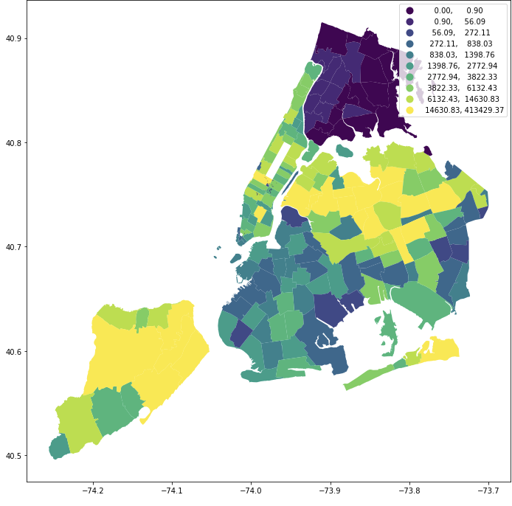
Water Demand in NYC
Input data
2020 Annual water use data by ZIP, type of industry
2015 Daily water use by county
Population by zip
Process
Combine data, create estimated data by county, zip, sectors
Challenges
Large discrepancies between two input data
Inaccessible data
Notes:
We used data of 2020 annual water consumption in privately owned buildings by type of industry and 2015 Daily water demand data by county level from United State geological survey to create an estimated water demand data for later modeling and research. Visualization above shows water demand by zip codes from estimated water demand data we created. average and by zip code it varies from
Although 2020 annual water consumption was in zip level , 40 % of the data was unavailable . So we calculated percentages from 2020 zip level data set and applied to 2015 dailly water use data which covers larger boundaries of industry and locations to create our final data set.
Alos there are large discrepancies between two input data sets we used .The two data set deviate from each other by 466676.62060191977 at county level.
. the final output data is also an estimate ( from county-level input database) and it can be way off from input data. Therefore, more effort to collect actual data to inform decision making is needed.
1.23-130 sec
Most of the data we found had not standard formatting, so we took a lot of time cleaning and processing them.

Slide 25
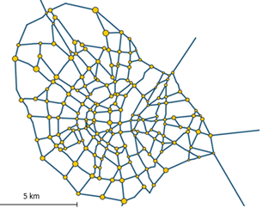
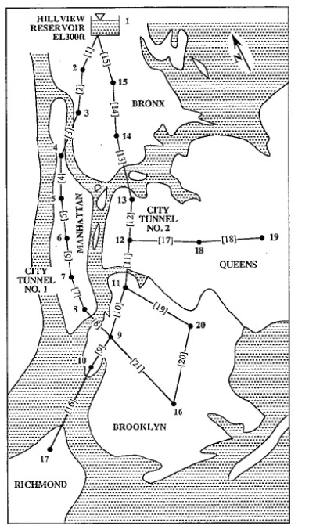
Related Literature and prior works
NYC’s water distribution system[4]
Gravity-based network models for water distribution [1,2,3]
Notes:
Water distribution data is highly sensitive and often openly unavailable, so we took inspiration from a work where model is developed that allows the topology of an urban water infrastructure to be mapped using freely available data. The parallelism of water and urban transportation infrastructures is used to identify the topology of a network by applying optimization methods.
Another study aimed to develop a method that locates critical nodes without hydraulic analysis of every failure scenario. The Flow Distribution method is the application of the gravity model, typically used to predict traffic flows in transportation engineering, to a distribution system. Flow distribution predicts the amount of demand and population that would be affected if any node in the system were disabled by solving for the distribution of each node’s outflow.

Slide 26
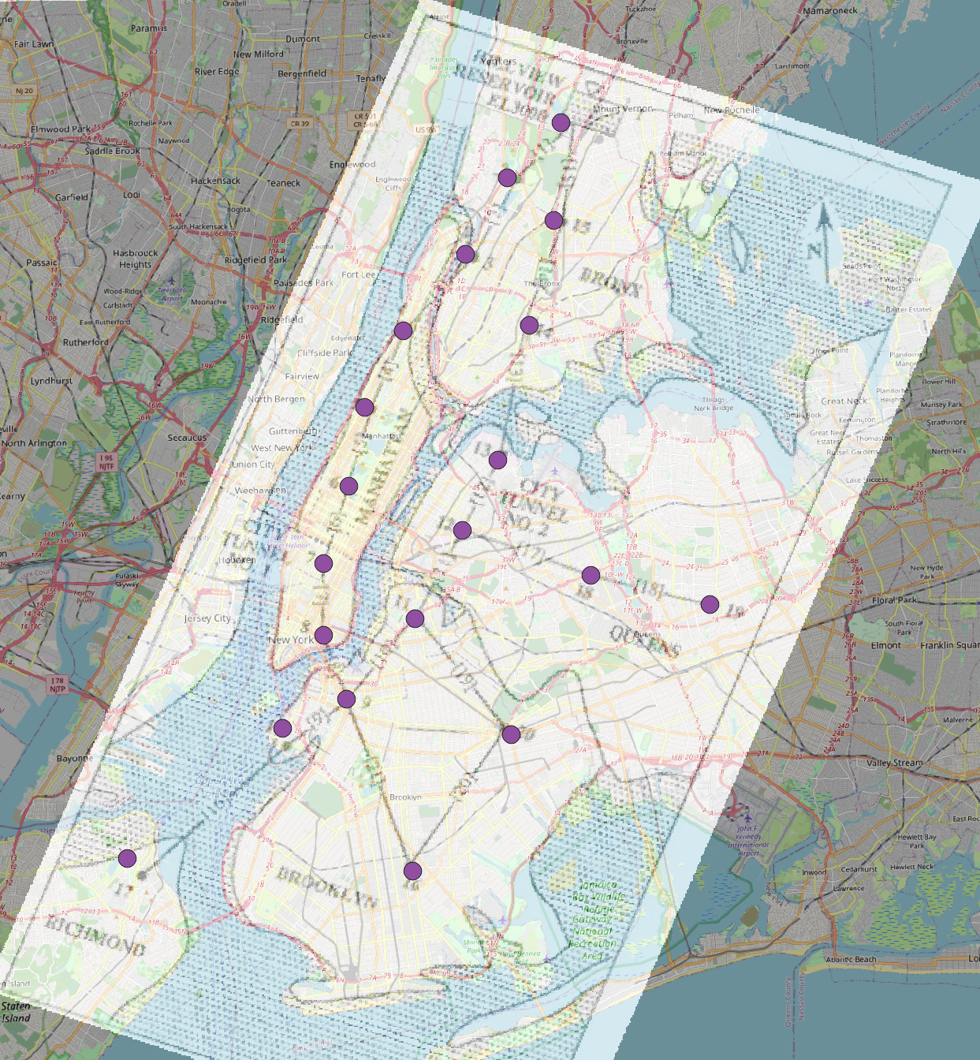
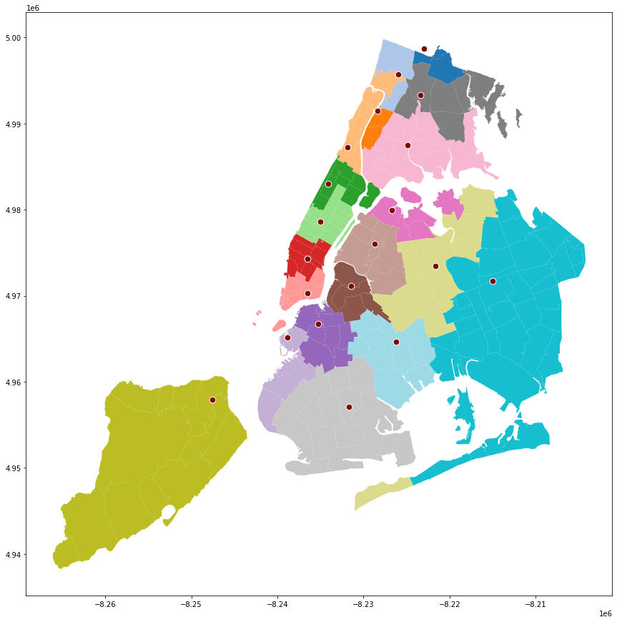
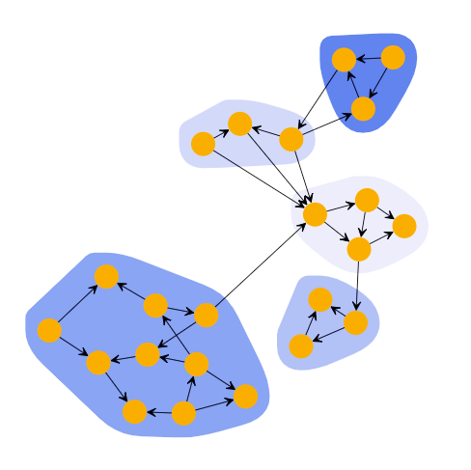
Methodology
Data inputs
Processing
Results
Network Spatial overlap
Distribution tunnels
Scaled image of water distribution tunnels + capacity
Gravity clustering
Water demand
Zip code level water demand data processed by team
Notes:
The main purpose of our project was to build a end to end spatial network of the water distribution system connected to each zipcode
Our key inputs were the scaled image of water distribution tunnels and their corresponding outflow nodes. We overlayed the image onto NYC spatial data using ArcGIS. By marking key landmarks common to the image and the map, we were able to align them and create spatial points of each tunnel node.
We used gravity-based clustering to identify the nearest distribution node to each zipcode in New York. The capacity of the tunnels and the calculated demand of each zipcode were added in as ancillary data for understanding demand impact of each node and tunnel.

Slide 27
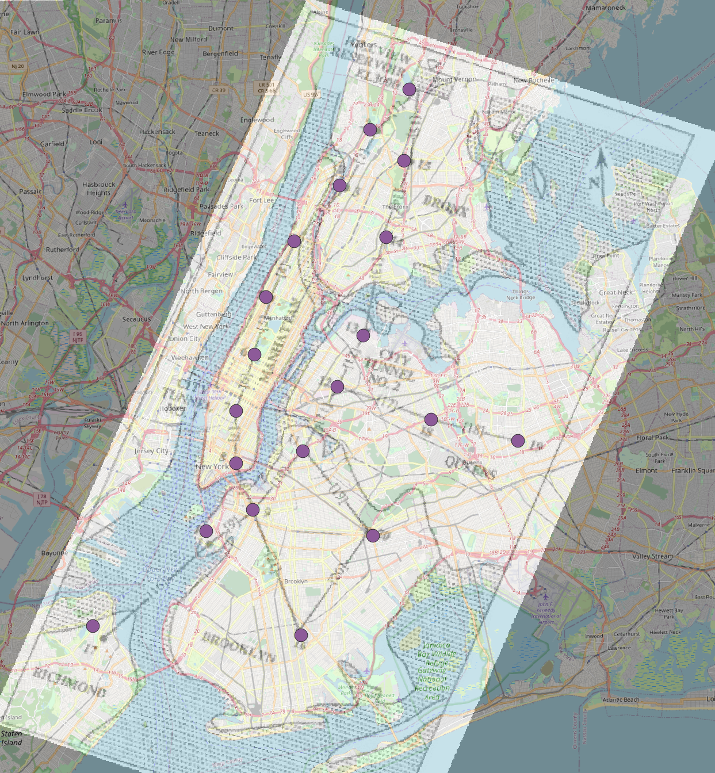
Water Supply Network – tunnel digitization
Digitized locations of water supply tunnel nodes
Notes:
Inputs
Tunnel image
New York City spatial data
Process
Creating overlay in ArcGIS by labelling key landmarks common to image and spatial map
Marking spatial points on map after overlap identified
Challenges
Image based on older map of NYC. Faced challenges with reconciliation because the image map was based on much older snapshot of new York city
Manually moved some tunnel node points to be placed under major road network (to reflect reality)

Slide 28
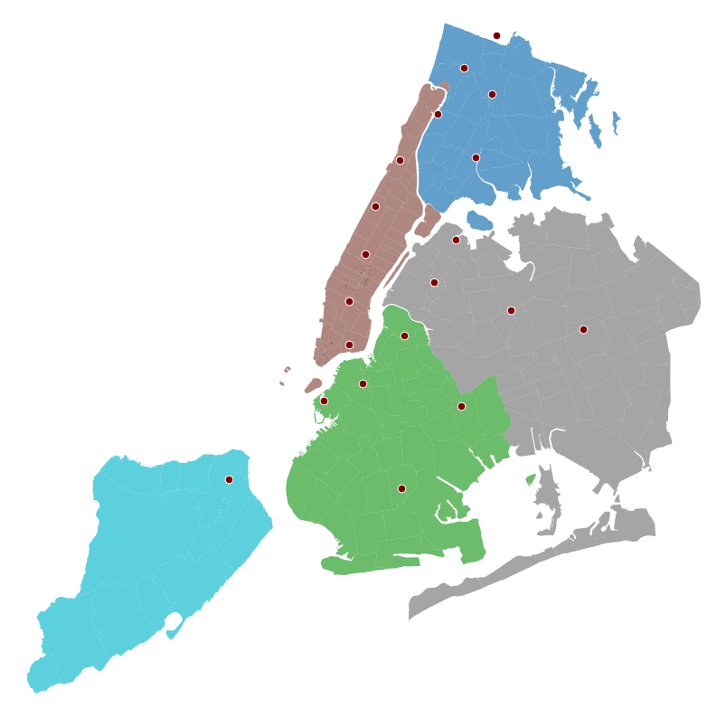
Water Supply Network – tunnel digitization
Point locations for network analysis

Slide 29
Zip Code Level Water Distribution Network
Conclusion
Quantify local level impact of natural and man-made disruptions to the water and electricity infrastructure
Policy Implications
Drive granular hardening policies against climate change and cyber-attacks
Next Steps
Run scenarios on disruption to water supply
Segmentation study of population impacted in different zip codes
Notes:
Inputs
Zipcode level water demand
Tunnel node capacity
Spatial polygons for zip codes, points for nodes
Process
Use geospatial package shapely to create a function for getting nearest point to a polygon
Use function for each borough to get nearest tunnel node to zipcode
Challenges
Understanding the discrepancy where Inflow > Capacity

Slide 30
Agenda
Motivation and Intention
Need for the project
Key research questions
Scenarios
Database creation
Challenges and lessons learnt
Conclusions
Challenges and Limitation
Contribution

Slide 31


Contributions of the project
End-to-end Water supply network
Water consumption current demand
Future demand and treatment needs
Combined Sewer Outflow network
Precipitation impact on city
Demographics correlated to sewer issues
Water
Waste- water

Slide 32
Challenges
Data not available publicly
Discrepancies in the processed data
Outliers
Complicated distribution network
Data not machine friendly
Domain knowledge needed
Water
Waste- water

Slide 33
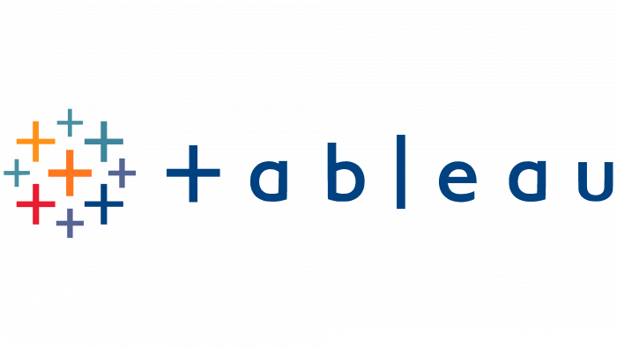






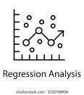
Data sources, tools and techniques
Spatial Analysis
Notes:
At least 3 min , data collection curation modeling implication , large data set , familiar with different agency , a lot of software and programs , show our contribution
Most of our data sources came from nyc government page, open data and United States Geological Survey. Python was the main programming language we utilized for data curation, modeling, and implications on available datasets before applying different techniques to dive deeper into details in terms of creating our desired databases and models. For the wastewater infrastructure scenario, we brought Tableau in for visualization of NYC map separated clearly by zip codes, and used techniques like regression and spatial analysis to find what is better to implement after viewing the results.

Slide 34
References
[1] Michael Hopkins. (2012). CRITICAL NODE ANALYSIS FOR WATER DISTRIBUTION SYSTEMS USING FLOW DISTRIBUTION. Master’s thesis, California Polytechnic State University
[2] Diao, Kegong; Farmani, Raziyeh; Fu, Guangtao; and Butler, David, "Vulnerability Assessment Of Water Distribution Systems Using Directed And Undirected Graph Theory" (2014). CUNY Academic Works.
[3] Rehm, I.-S.; Friesen, J.; Pouls, K.; Busch, C.; Taubenböck, H.; Pelz, P.F. A Method for Modeling Urban Water Infrastructures Combining Geo-Referenced Data. Water 2021, 13, 2299. https:// doi.org/10.3390/w13162299
[4] Dandy, Graeme & Simpson, Angus & Murphy, Laurence. (1996). An improved genetic algorithm for pipe network optimisation. Water Resources Research. 32.
[5] The dangers of combined sewer overflows - mswmag.com. (n.d.). Retrieved July 27, 2022, from https://www.mswmag.com/online_exclusives/2019/04/the-dangers-of-combined-sewer-overflows_sc_003d9
Notes:
The dangers of combined sewer overflows - mswmag.com. (n.d.). Retrieved July 27, 2022, from https://www.mswmag.com/online_exclusives/2019/04/the-dangers-of-combined-sewer-overflows_sc_003d9

Slide 35
Thank You!

